Slide 1
VOS
DEMANDES
Et des éléments de réponses qui, je l’espère , vous seront utiles

Slide 2
Regroupement des demandes
À la réponse : « Dites-moi en commentaire vos besoins particuliers, ou ce que vous souhaiteriez que l'on aborde pendant la formation. », voici ce qui en est ressortie :
Un point global justement sur boucle/condition/écouteur, leur périmètre d'action/utilité, leur syntaxe et fonctionnement dans notre version Js/JQuery actuelle.
Une vue d'ensemble en rappelant les bases, avec des exercices pratiques si possible.
Gagner de l'expérience sur l'utilisation de JS, meilleure manipulation, code plus propre, découverte de fonctionnalité qui reviennent régulièrement sur la demande client, exemple d'animations via JS ... Le but c'est de savoir bien le manipuler pour être force de proposition sur des sites avec des demandes un peu plus poussé en terme d'animations ou autre.
L'utilisation de libraires js, les local storage / session storage, j'ai aussi du mal à bien comprendre le fonctionnement des boucles et surtout à savoir quand les mettre en application. Je ne suis pas très à l'aise non plus avec javascript Vanilla, un petit rappel dessus serait intéressant :)
Je suis intéressé par le onclick, la récupération, le stockage et la restitution de données
Revoir le JS en général (revoir la logique et l'utilisation du localstorage, fonctions, boucles, conditions, ...) afin d'être plus efficace et rapide. Personnellement, j'ai régulièrement des doutes, en revoyant un petit peu tout, il serait plus rapide de coder.

Slide 3
01
Ce qui ressort de vos demandes
Nous allons essayer de regrouper celles-ci par thématiques afin d’étudier chaque section qui émane de vos demandes initiales

Slide 4
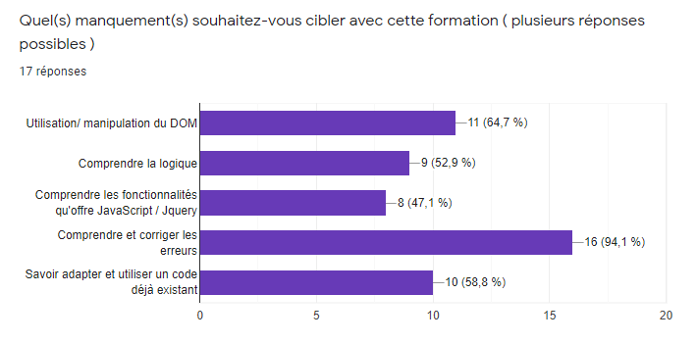
Et avec des chiffres ça donne quoi ?
Connaissance :
* datas récupéré lors du dernier questionnaire

Slide 5
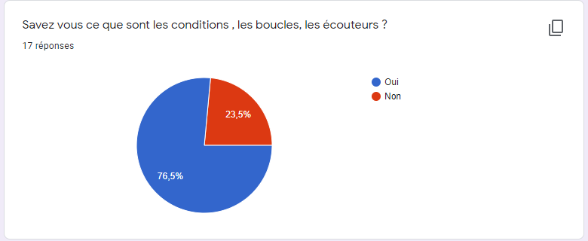
Connaissance des concepts de base
Compréhenssion :
Nous pouvons voir que la majorité d’entre-vous savent ce que sont des écouteurs, des boucles et des conditions.
* datas récupéré lors du dernier questionnaire

Slide 6
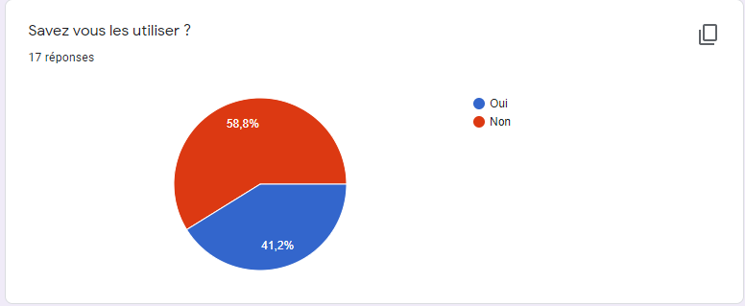
Et avec des chiffres ça donne quoi ?
Application :
Dans ce graphiques suivant, nous pouvons voir que le problème concerne plutôt l’utilisation de ces conceptes. Ce qui ressort souvent en programmation haut niveau : le devellopeur possède une comprenhesion des différentes logique, mais a dû mal à les appliquer dans un contexe donné.
* datas récupéré lors du dernier questionnaire

Slide 7
1st Revoir les basiques
Dans la liste de vos demandes, une chose ressort plus que les autres : Une aide globale à la compréhension des classiques de JavaScript :
Les fonctions
Les boucles
Les conditions
Mais aussi les selecteurs et les écouteurs d’événements

Slide 8
2nd Les mains dans le moteur JS
Fonction
Comprendre ce qu’est une fonction
Les événements
La partie centrale de JavaScript se situe principalement à ce niveau, nous allons donc analyser de plus près ce concept
Boucle
Conditions
Comprendre les différentes boucles et les utiliser
Comprendre ce concept et l’appliquer

Slide 9
02
IN DEPTH
You can enter here the subtitle if you need it

Slide 10

IN DEPTH
MERCURY
Mercury is the closest planet to the Sun and the smallest one in the Solar System—it’s only a bit larger than our Moon.

Slide 11
OUR NUMBERS
500
100
40
new clients last semester
ongoing projects
new employees last semester

Slide 12
SECTOR NEWS
VENUS
MARS
SATURN
Despite being red, Mars is a cold place, not hot. It’s full of iron oxide dust, which gives the planet its reddish cast
Venus has a beautiful name and is the second planet from the Sun. It’s terribly hot, even hotter than the other planets
Yes, this is the ringed one. It’s a gas giant, composed mostly of hydrogen and helium. It’s named after the Roman god

Slide 13
03
IN BRIEF
You can enter here the subtitle if you need it

Slide 14
NEWS
NEPTUNE
MARS
MERCURY
JUPITER
VENUS
SATURN
Neptune is the farthest planet from the Sun
Despite being red, Mars is actually a cold place
Mercury is the smallest one in the whole Solar System
Jupiter is the fourth-brightest in our Solar System
Venus has a beautiful name and is terribly hot as well
Yes, Saturn is the ringed planet. It’s a gas giant

Slide 15
CUSTOMER REVIEWS
RICHARD ROE
HELENA PATTERSON
“Neptune is the farthest planet from the Sun and the fourth-largest planet in our Solar System!”
“Despite being red, Mars is a cold place. It’s full of iron oxide dust, which gives the planet its reddish cast”

Slide 16
THIS IS A TABLE
 | ISSUE 1 | ISSUE 2 | ISSUE 3 | ISSUE 4
VENUS | 12 | 32 | 23 | 45
MERCURY | 67 | 23 | 45 | 65
MARS | 67 | 49 | 78 | 34

Slide 17
04
WELCOME!
You can enter here the subtitle if you need it

Slide 18


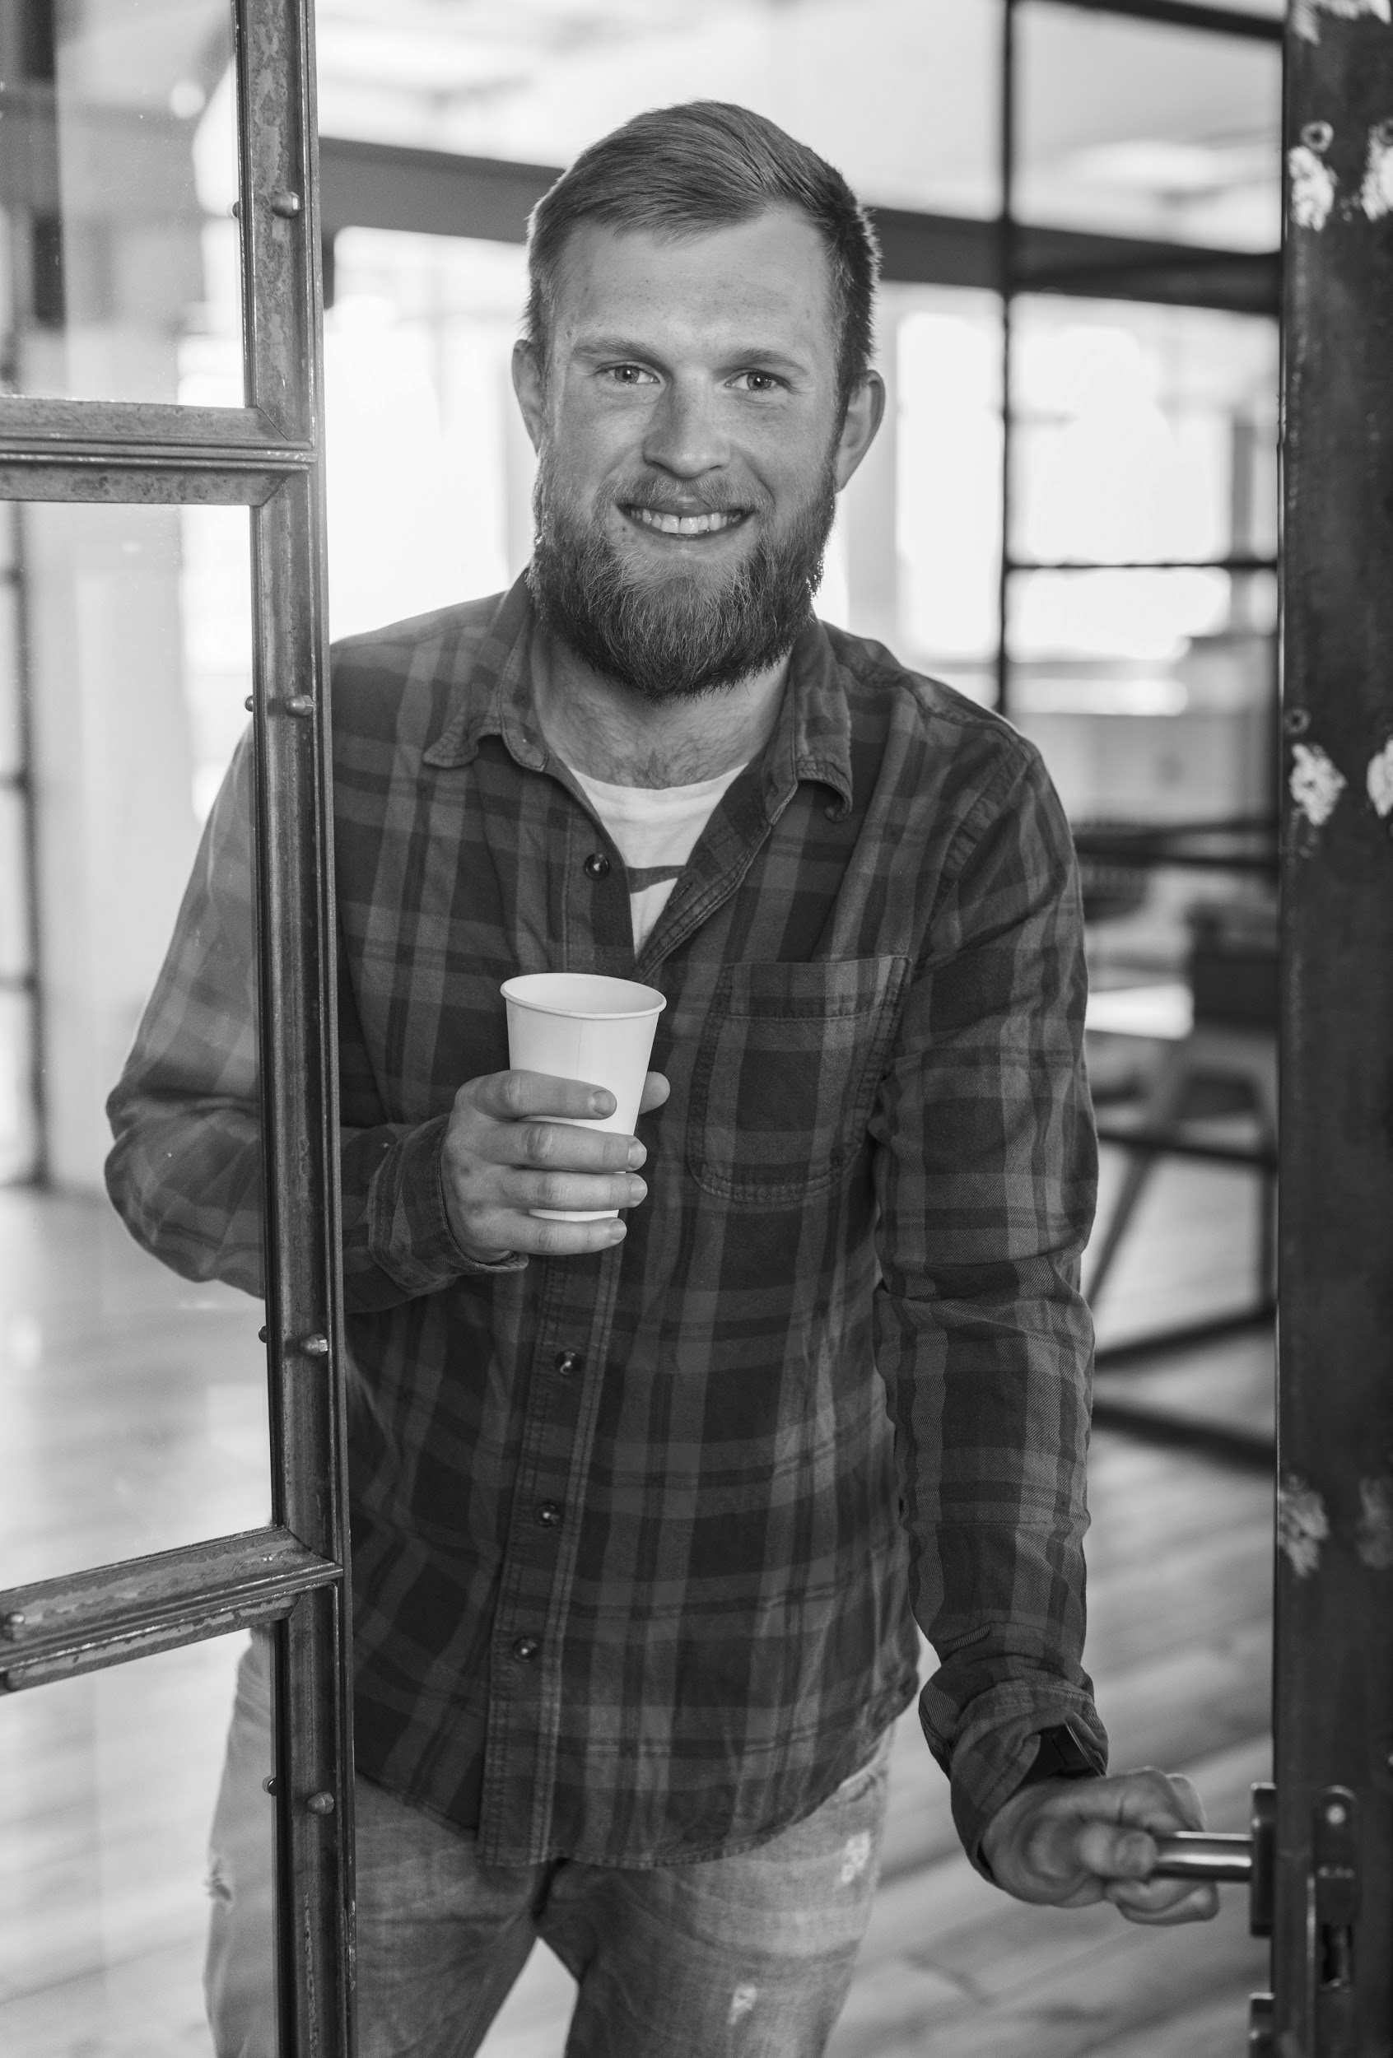

WELCOME!
MARY RUIZ
JOHN SMITH
JONATHAN DOE
MINA HAWKINS
Neptune is the farthest planet from the Sun and the fourth-largest
Despite being red, Mars is a cold place, not hot. It’s full of iron oxide dust
Mercury is the closest planet to the Sun and the smallest one
Venus has a beautiful name and is the second planet from the Sun

Slide 19
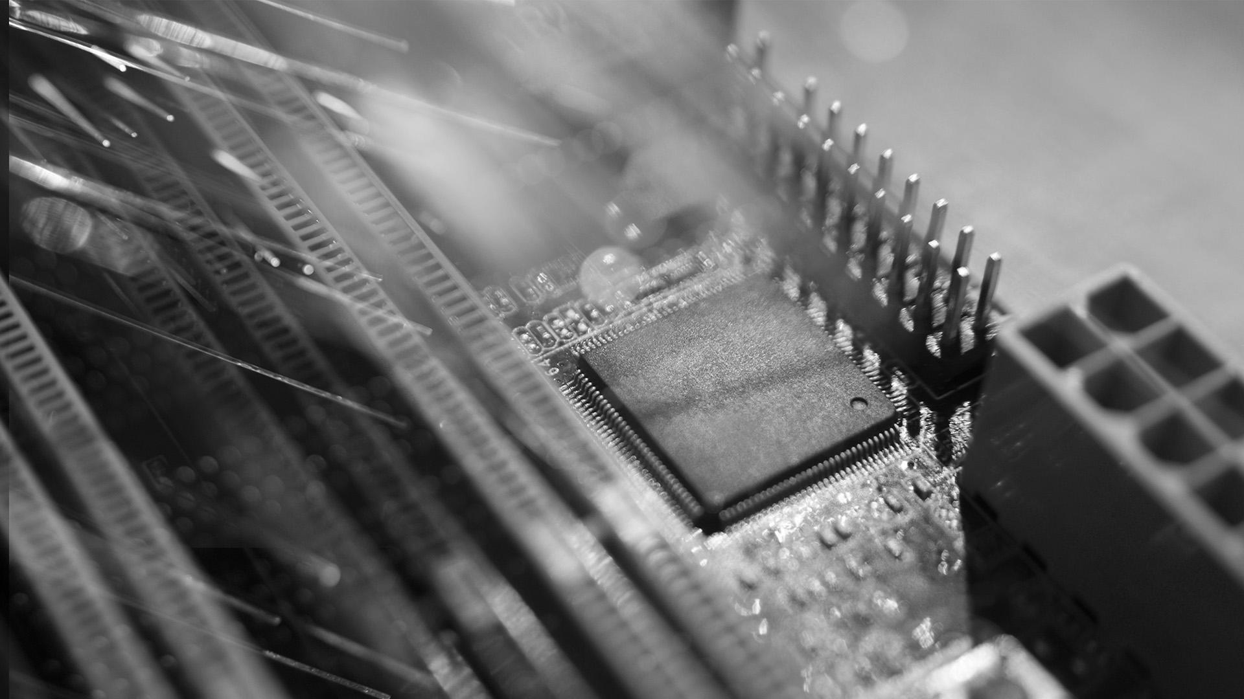
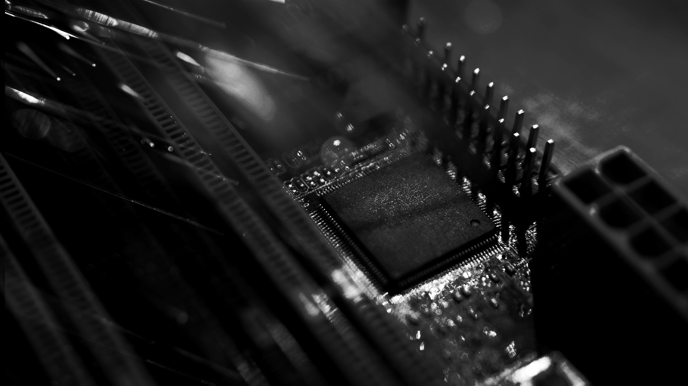
AWESOME WORDS

Slide 20
05
EVENTS
You can enter here the subtitle if you need it

Slide 21
REVIEW OF PAST EVENTS
Despite being red, Mars is a cold place, not hot
Jupiter is the biggest planet in our Solar System
FEB 02
APR 16
JAN 14
MAR 10
MAY 30
It is the closest planet to the Sun and the smallest
Saturn is composed of hydrogen and helium
Neptune is the farthest planet from the Sun

Slide 22
UPCOMING EVENTS
SEP 08
Mercury is the closest planet to the Sun
NOV 29
Saturn is composed of hydrogen
OCT 16
Despite being red, Mars is a cold place
DEC 10
Jupiter is the biggest planet in our Solar System

Slide 23
06
SNEAK PEEK
You can enter here the subtitle if you need it

Slide 24
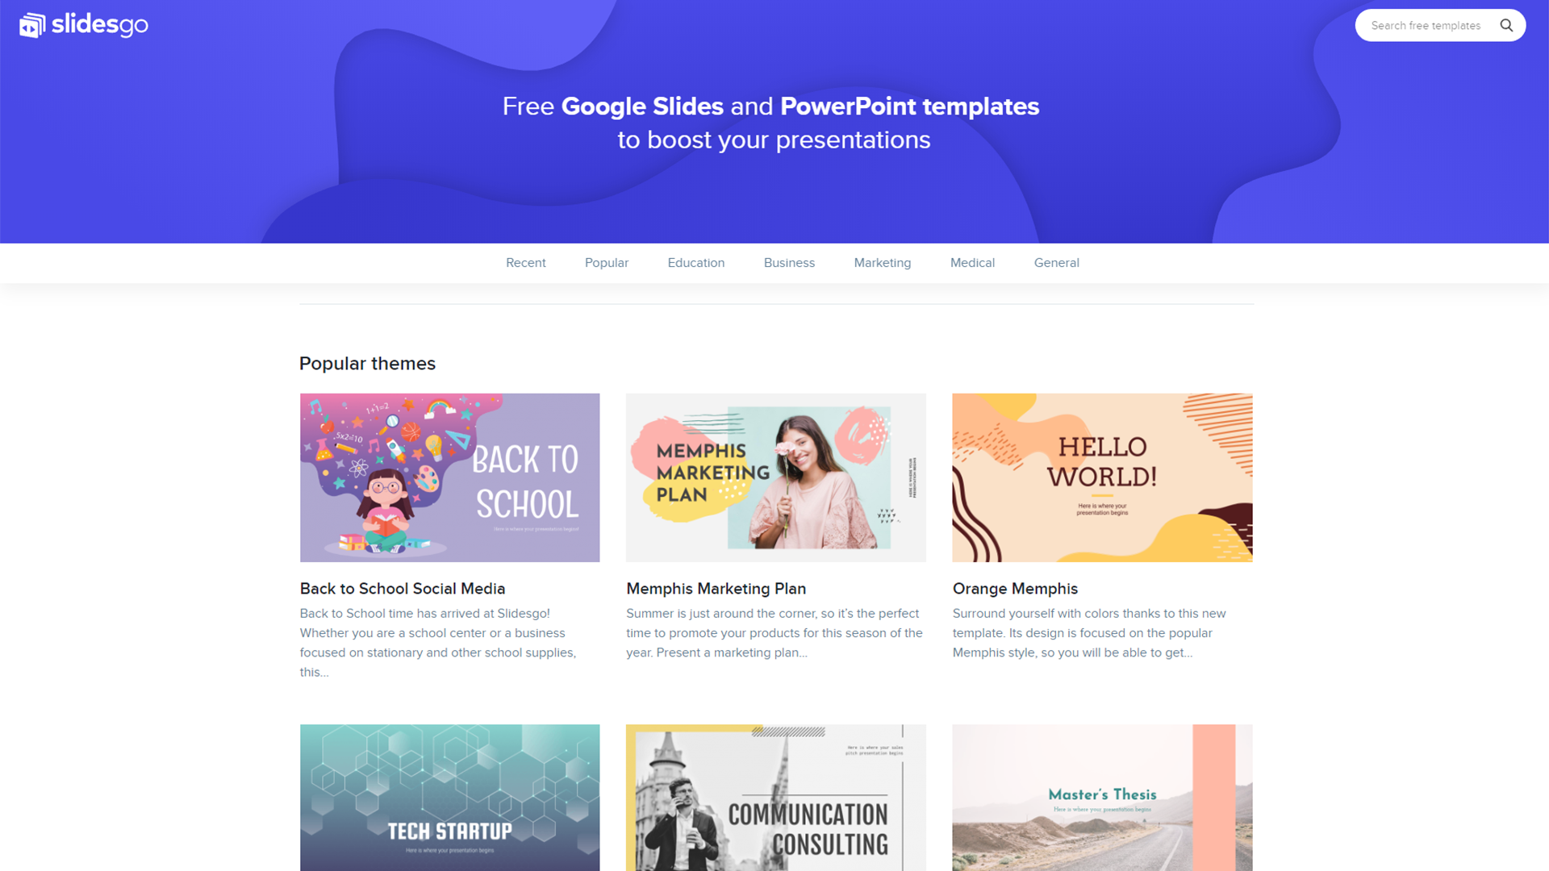
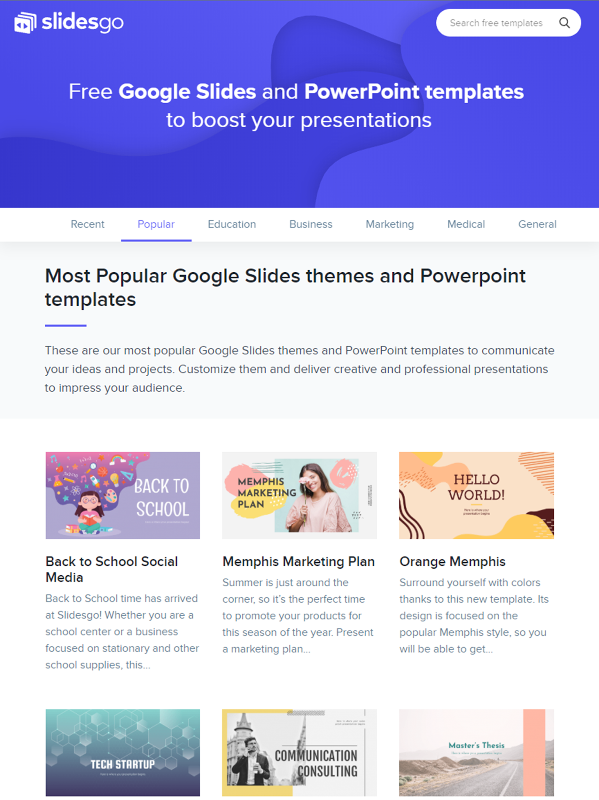
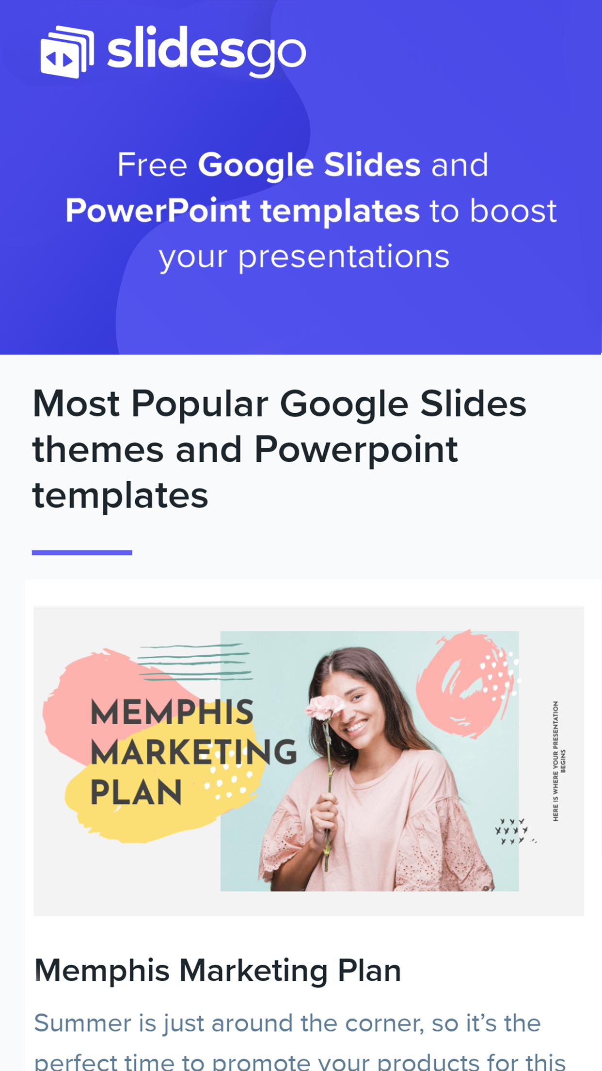
SNEAK PEEK
Neptune is the farthest planet from the Sun and the fourth-largest in our Solar System

Slide 25
THANKS
Does anyone have any questions?
addyouremail@freepik.com
+91 620 421 838
yourcompany.com

Slide 26
RESOURCES
Did you like the resources on this template? Get them for free at our other websites.
PHOTOS
Woman using smartphone with hologram
Happy businesswoman looking at camera with holding pencil and diary
Portrait of smiling man holding digital tablet looking at camera
Smiling bearded man holding disposable coffee cup while opening door
Portrait of pretty woman holding laptop looking at camera
Motherboard with optical fiber
Futuristic technology screen interface
Front view of businessman holding high tech tablet
Businessman holding the newspaper and smiling
Multiracial group of cheerful coworkers
Happy young couple exchanging love messages
Smiling business people team sitting around the table in the meeting
VECTORS
Technology background with gradient colors
Blue 5g concept background
Abstract landing pages with technology devices
PREMIUM ICONS
Big Data Icon pack
PREMIUM PHOTOS
Short haired business woman laughing

Slide 27
Instructions for use (free users)
In order to use this template, you must credit Slidesgo by keeping the Thanks slide.
You are allowed to:
Modify this template.
Use it for both personal and commercial purposes.
You are not allowed to:
Sublicense, sell or rent any of Slidesgo Content (or a modified version of Slidesgo Content).
Distribute this Slidesgo Template (or a modified version of this Slidesgo Template) or include it in a database or in any other product or service that offers downloadable images, icons or presentations that may be subject to distribution or resale.
Use any of the elements that are part of this Slidesgo Template in an isolated and separated way from this Template.
Delete the “Thanks” or “Credits” slide.
Register any of the elements that are part of this template as a trademark or logo, or register it as a work in an intellectual property registry or similar.
For more information about editing slides, please read our FAQs or visit Slidesgo School:
https://slidesgo.com/faqs and https://slidesgo.com/slidesgo-school

Slide 28
Instructions for use (premium users)
In order to use this template, you must be a Premium user on Slidesgo.
You are allowed to:
Modify this template.
Use it for both personal and commercial purposes.
Hide or delete the “Thanks” slide and the mention to Slidesgo in the credits.
Share this template in an editable format with people who are not part of your team.
You are not allowed to:
Sublicense, sell or rent this Slidesgo Template (or a modified version of this Slidesgo Template).
Distribute this Slidesgo Template (or a modified version of this Slidesgo Template) or include it in a database or in any other product or service that offers downloadable images, icons or presentations that may be subject to distribution or resale.
Use any of the elements that are part of this Slidesgo Template in an isolated and separated way from this Template.
Register any of the elements that are part of this template as a trademark or logo, or register it as a work in an intellectual property registry or similar.
For more information about editing slides, please read our FAQs or visit Slidesgo School:
https://slidesgo.com/faqs and https://slidesgo.com/slidesgo-school

Slide 29
Fonts & colors used
This presentation has been made using the following fonts:
Exo 2
(https://fonts.google.com/specimen/Exo+2)
Roboto Condensed
(https://fonts.google.com/specimen/Roboto+Condensed)
#434343
#eeeeee
#ffffff

Slide 30





Stories by Freepik
Create your Story with our illustrated concepts. Choose the style you like the most, edit its colors, pick the background and layers you want to show and bring them to life with the animator panel! It will boost your presentation. Check out How it Works.
Pana
Amico
Bro
Rafiki
Cuate

Slide 31
Use our editable graphic resources...
You can easily resize these resources without losing quality. To change the color, just ungroup the resource and click on the object you want to change. Then, click on the paint bucket and select the color you want. Group the resource again when you’re done. You can also look for more infographics on Slidesgo.

Slide 34
JANUARY
FEBRUARY
MARCH
APRIL
MAY
JUNE
PHASE 1
Task 1
Task 2
PHASE 2
Task 1
Task 2
JANUARY
FEBRUARY
MARCH
APRIL
PHASE 1
Task 1
Task 2

Slide 37
...and our sets of editable icons
You can resize these icons, keeping the quality.
You can change the stroke and fill color; just select the icon and click on the paint bucket/pen.
In Google Slides, you can also use Flaticon’s extension, allowing you to customize and add even more icons.

Slide 38
Educational Icons
Medical Icons

Slide 39
Business Icons
Teamwork Icons

Slide 40
Help & Support Icons
Avatar Icons

Slide 41
Creative process Icons
Performing Arts Icons

Slide 42
Nature Icons

Slide 43
SEO & Marketing Icons

Slide 44


